Slide 1

Employee Exit Process - Provident Fund & Pension

Slide 2


Schemes offered under EPFO
Provident Fund (Withdrawal)
PF & Pension Tenure (Transfer Out)
Employees’
Pension Scheme
1995 (EPS)
Query Management

Slide 3
Provident Fund & EPS Transfer-Out Application Procedure

Slide 4
Provident Fund Transfer Out Application Procedure
01
Arrange Pre-Requisite for PF Transfer
02
Login into HCL’s Offboarding Portal and click on PF Portal Link
03
ESS Facto HR Auto Login facility
04
Click on Transactions and choose Transfer Out Application Option
05
Fill-in current employers’ details
06
Attach copy of form 13 and submit the application
Kindly refer to the attached full procedure of application -

Slide 5
Provident Fund Transfer Out Application Procedure
Form 13 generation procedure on EPFO Portal
Step 1: Log in to the EPFO website using your Universal Account Number (UAN) and the password. Step 2: Under the “Online Services” tab, select “One Member - One EPF Account (Transfer Request)”. Detailed procedure has been explained in the next slides.
Download the form 13 from EPFO portal and follow below steps to upload the form on HCL portal to transfer the fund.
1
2

Slide 6

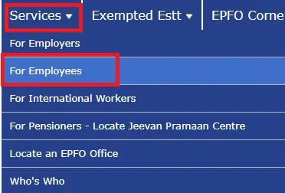
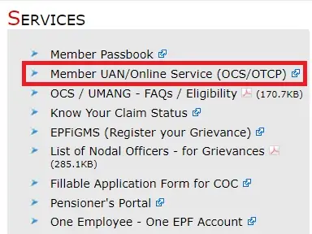
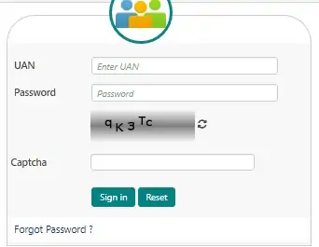
EPFO Login for Employees – Generate form 13
Go to the EPFO
Unified Login portal / open below Link https://unifiedportal-mem.epfindia.gov.in/memberinterface/
Under ‘Services’ section,
click on ‘For Employees’.
As the new dashboard opens
up, go to Member UAN/Online Services (in the ‘Services’ section). You can also go directly to the EPFO Member Portal/e-SEWA Portal.
Now login using UAN which is possible if you have an activated UAN (Universal Account Number). Below the ‘login’ section, there’s also an option to activate UAN. In case you have not activated it, click on ‘Activate UAN’

Slide 7
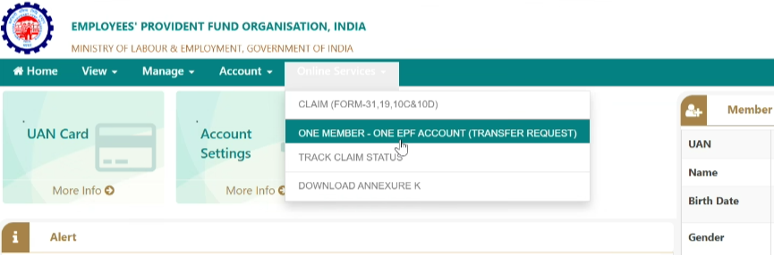
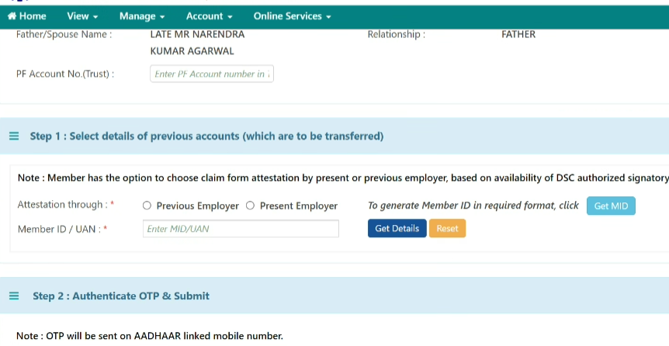
Form 13 (PF Transfer out) Generation Procedure
Post login, click on Online Services and then ONE MEMEBR – ONE EPF ACCOUNT (TRANSFER REQUEST)
Entre Current PF Number, Select current employer and enter member id / UAN id and click on Get Details…

Slide 8
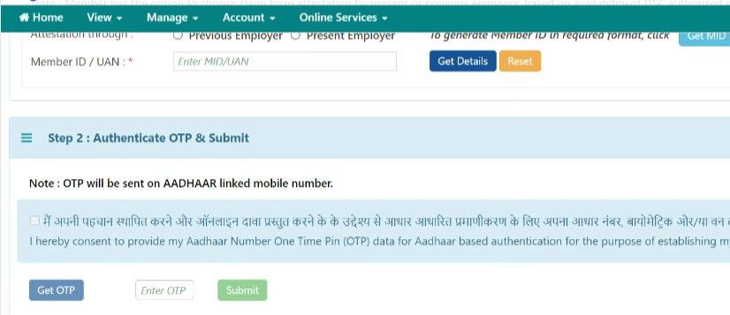
Form 13 (PF Transfer out) Generation Procedure
Click on Get OTP, Enter OTP and submit.
Post submit it, download the application form and follow the procedures explained on next slides to upload the form on HCL PF Portal.

Slide 9
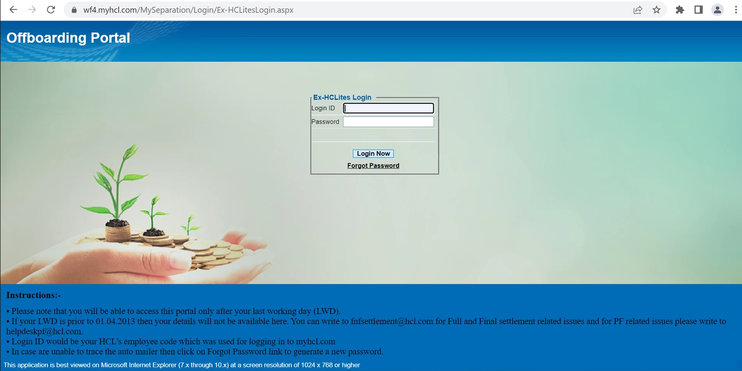
Offboarding Login Procedure
Step 1: Please visit separation portal through this link https://wf4.myhcl.com/MySeparation/Login/Ex-HCLitesLogin.aspx. (Separation portal will open as provided below in screenshot)
Login Id /Password : Please enter your SAP id and password, an OTP will be triggered to the Personal Email Id (OTP is valid for 10 minutes only). Please check spam folder in case OTP is not received in the INBOX.
Forgot Password : Please enter SAP id / Employee id and click on Get Details button, and then enter PAN No. or Date of Birth, temporary password will be sent to the personal email id, this password will be valid only for 30 minutes. Employee is requested to change his password using temporary password.
Challenge in login to the portal, please send an email @ portal.login.issue@hcl.com along with error screenshot.

Slide 10
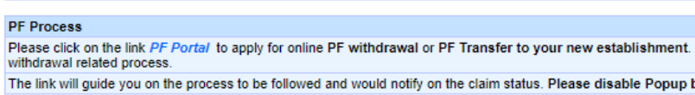
Provident Fund Transfer Out Application Procedure
Step 2 : Please click on the PF Portal link mentioned below on the next page as shown in the screenshot.
Note: If above link is not opening
Please try accessing portal in browser’s Incognito/InPrivate window, After left click (direct select) PF portal link, kindly check URL right side and disable popup blocker (choose Allow for site option)

Slide 11
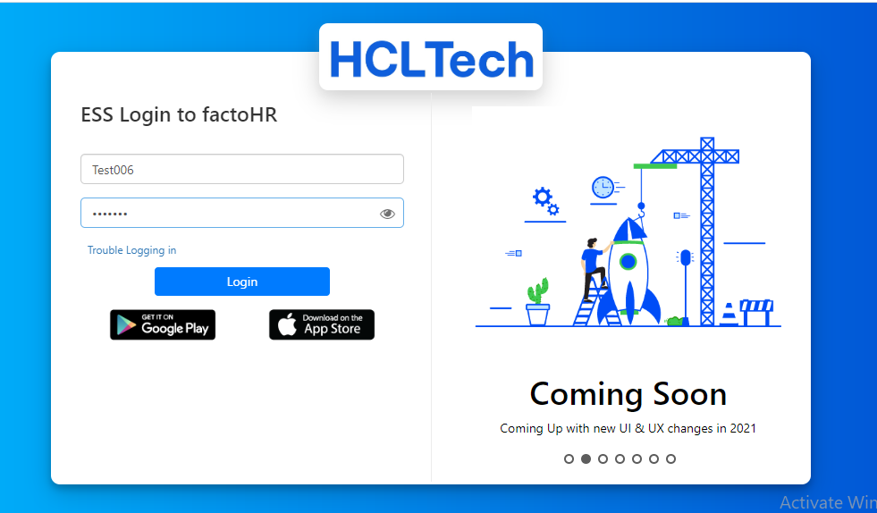
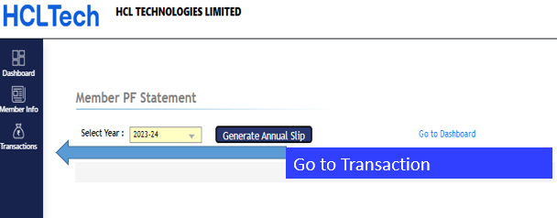
Provident Fund Transfer Out Application Procedure
Step 3: Wait for Auto Login
Wait….for auto login
Step 3.1 : Click on Transactions

Slide 12
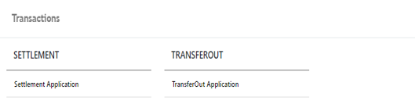
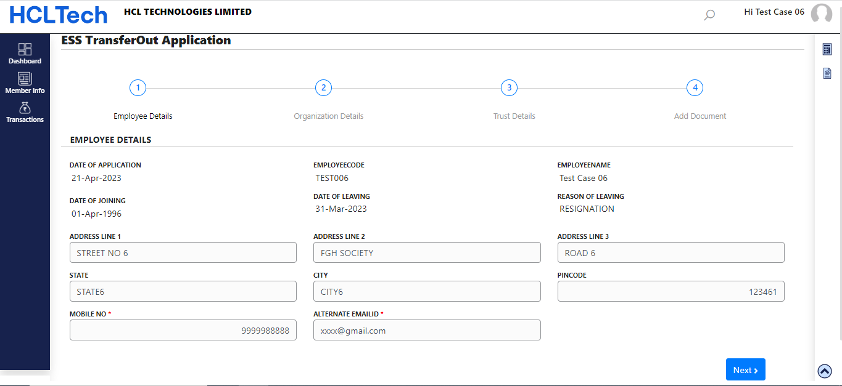
Provident Fund Transfer Out Application Procedure
Step 3.2 Click on Transfer Out Application
Step 3.3 Verify your basic details here and Click on Next

Slide 13
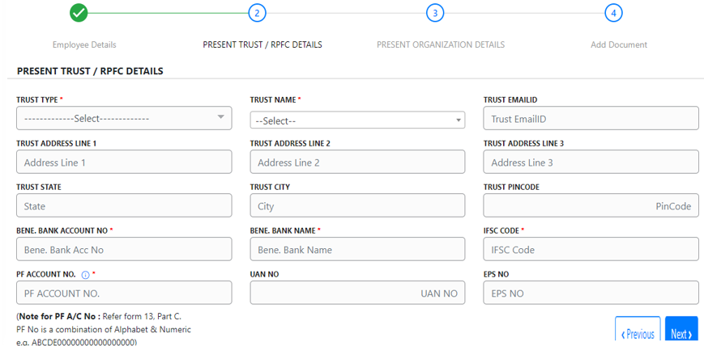
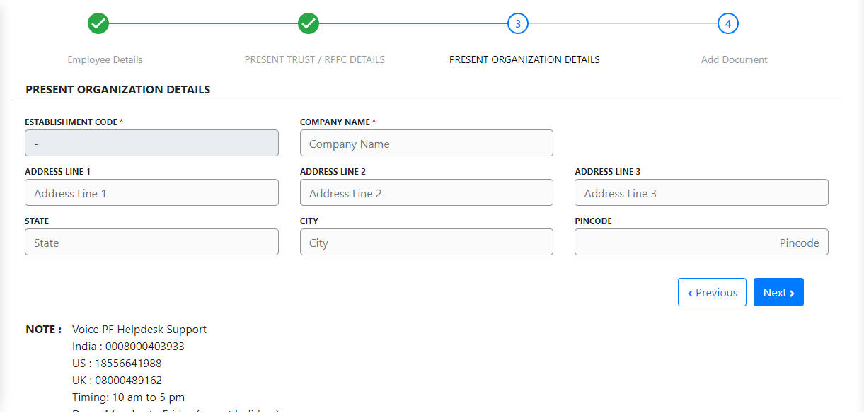
Provident Fund Transfer Out Application Procedure
Step 3.4 Fill the details and next
Step 3.5 Fill the details and next

Slide 14
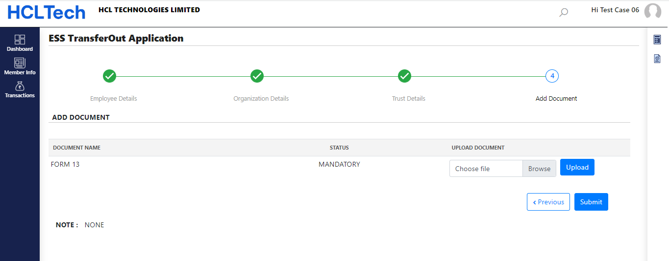
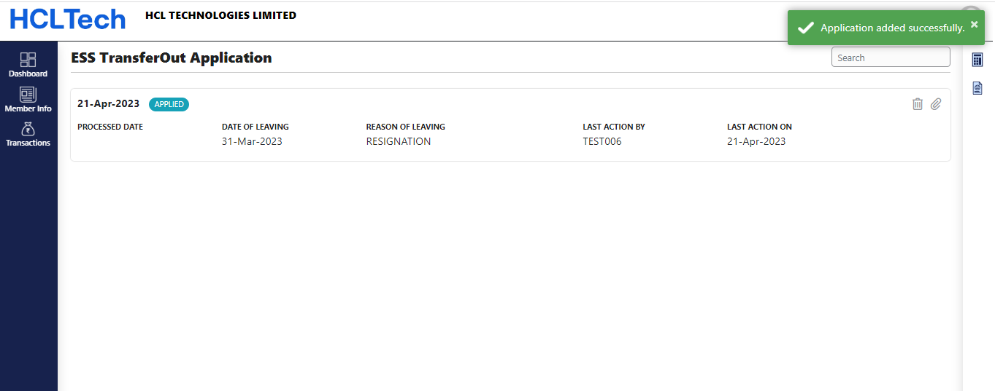
Provident Fund Transfer Out Application Procedure
Step 3.6 Choose form 13 and Upload
Step 3.7 Application Created successfully

Slide 15
Provident Fund Withdrawal Application Procedure

Slide 16
Provident Fund Withdrawal Application Procedure
01
Login into HCL’s Offboarding Portal and click on PF Portal Link
02
ESS Facto HR Auto Login Facility Available
03
Click on Transactions and choose Settlement Application Option
04
Choose Bank Account Type and fill in the details
05
Generate the form 19 & Form 15G/H and take the print for signature
06
Upload signed forms and other documents e.g. Copy of Aadhar, Pan & Bank proof.

Slide 17
Offboarding Login Procedure
Step 1: Please visit separation portal through this link https://wf4.myhcl.com/MySeparation/Login/Ex-HCLitesLogin.aspx. (Separation portal will open as provided below in screenshot)
Login Id /Password : Please enter your SAP id and password, an OTP will be triggered to the Personal Email Id (OTP is valid for 10 minutes only). Please check spam folder in case OTP is not received in the INBOX.
Forgot Password : Please enter SAP id / Employee id and click on Get Details button, and then enter PAN No. or Date of Birth, temporary password will be sent to the personal email id, this password will be valid only for 30 minutes. Employee is requested to change his password using temporary password.
Challenge in login to the portal, please send an email @ portal.login.issue@hcl.com along with error screenshot.

Slide 18
Provident Fund Withdrawal Application Procedure
Step 2 : Please click on the PF Portal link mentioned below on the next page as shown in the screenshot.
Note: If above link is not opening
Please try accessing portal in browser’s Incognito/InPrivate window, After left click (direct select) PF portal link, kindly check URL right side and disable popup blocker (choose Allow for site option)

Slide 19
Provident Fund Withdrawal Application Procedure
Step 3: Wait for Auto Login
Wait….for auto login
Step 3.1 : Click on Transactions

Slide 20
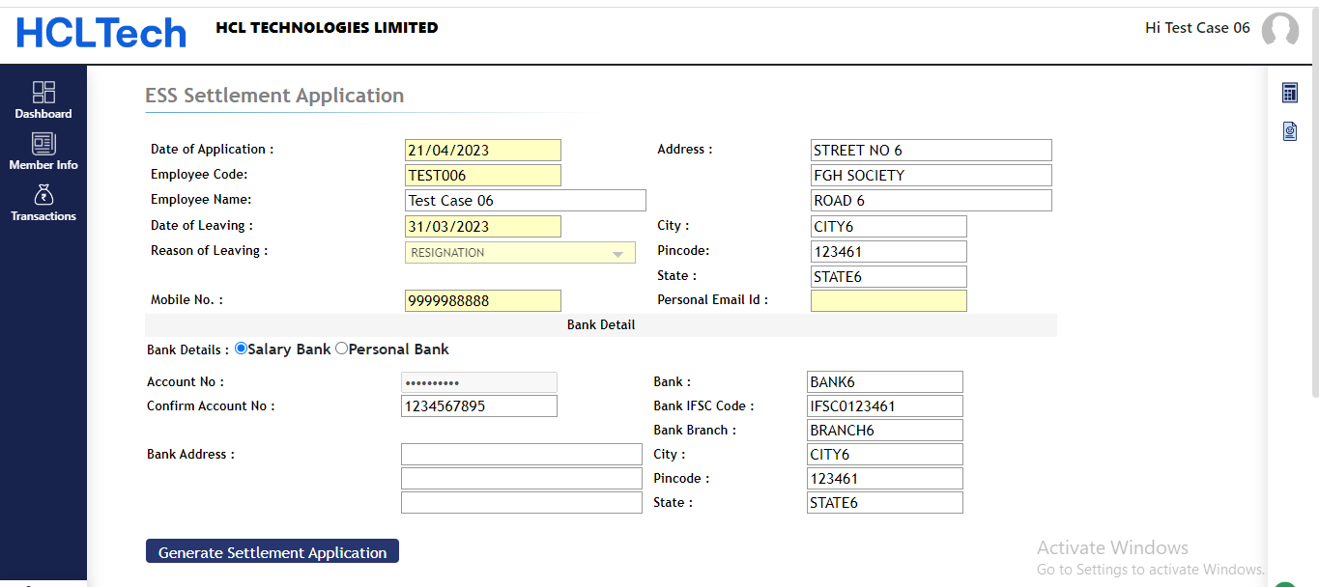
Provident Fund Withdrawal Application Procedure
Step 3.2 Click on Settlement Application
Step 3.3 Choose bank account and Fill the details and click on form 19 and form 15g/h to download the form.
Please do manual sign on generated forms and scan them to upload
Click here to generate Settlement Application

Slide 21
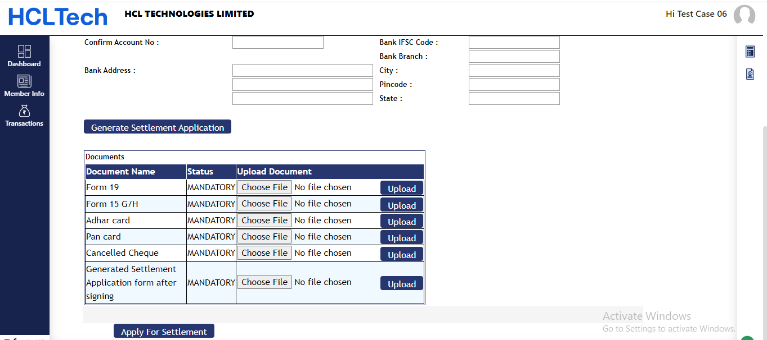
Provident Fund Withdrawal Application Procedure
Step 3.4 Choose File & Upload documents one by one and then click on Apply for settlement

Slide 22
Retirement Benefits (Employee Pension Scheme) Application Procedure

Slide 23
Pension Benefits under
Employees’ Pension Scheme (EPS)
Pension on Leaving Service before Becoming Eligible for Monthly Pension
Pension on Total Disablement during the Service
Pension for the Family on the Death of the Member
Pension on Retirement at the Age of 58 Years
A Family members become eligible for the pension benefits
In case of death of the member while in service and the employer has deposited funds in his EPS account for at least one month
In case of death of the member after the commencement of the monthly pension

Slide 24
EPFO Login for Employees
Go to the EPFO
Unified Login portal / open below Link https://unifiedportal-mem.epfindia.gov.in/memberinterface/
Under ‘Services’ section,
click on ‘For Employees’.
As the new dashboard opens
up, go to Member UAN/Online Services (in the ‘Services’ section). You can also go directly to the EPFO Member Portal/e-SEWA Portal.
Now login using UAN which is possible if you have an activated UAN (Universal Account Number). Below the ‘login’ section, there’s also an option to activate UAN. In case you have not activated it, click on ‘Activate UAN’

Slide 25
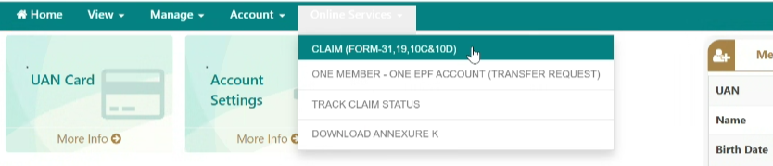
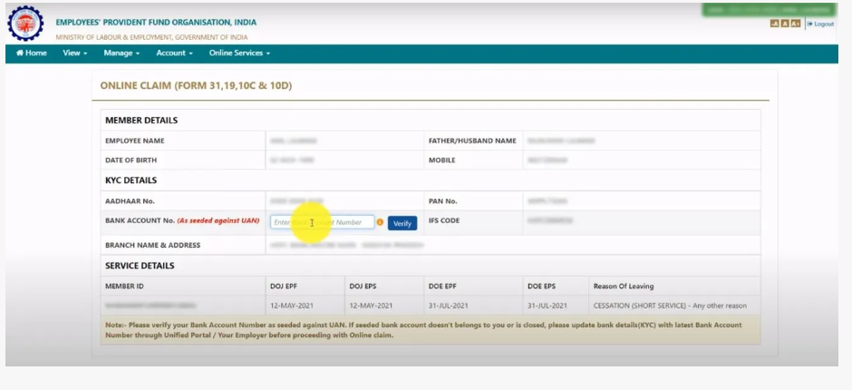
Online Application for Pension
Post login, click on CLAIM (FORM-31, 19, 10C & 10D)
Enter Bank account details

Slide 26
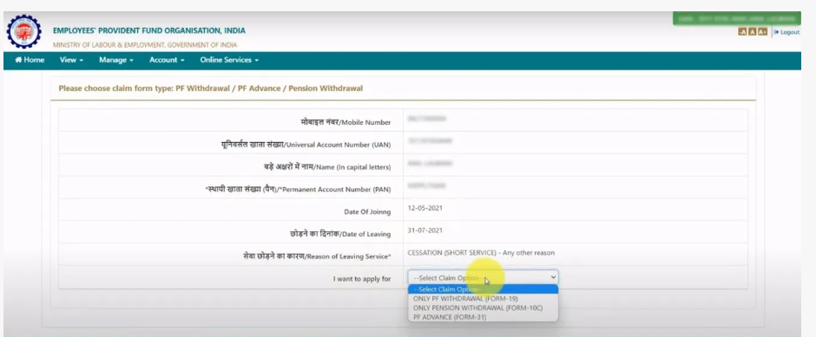
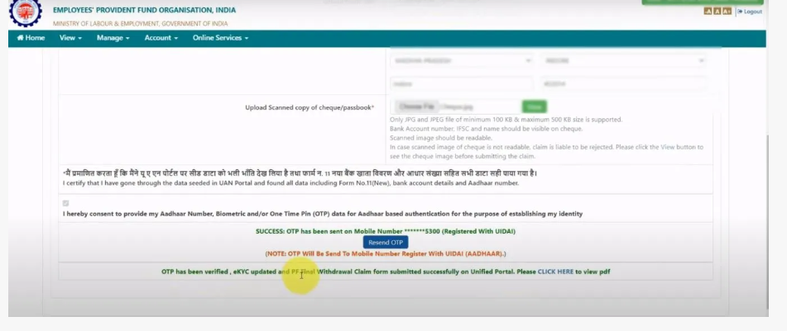
Online Application for Pension
Click on Only Pension Withdrawal, form 10C
Upload Copy of cheque and verify OTP and then submit application form.

Slide 27

Pension Benefits under Employees’ Pension Scheme (EPS)
Pension on Retirement at the Age of 58 Years
Pension on Leaving Service before Becoming Eligible for Monthly Pension
Pension on Total Disablement during the Service
Pension for the Family on the Death of the Member
A member’s family becomes eligible for the pension benefits
In case of death of the member while in service and the employer has deposited funds in his EPS account for at least one month
In case of death of the member after the commencement of the monthly pension

Slide 28
Online Grievance & Query Mgmt.
and
Voice Call helpdesk

Slide 29
Offboarding Login Procedure
Step 1: Please visit separation portal through this link https://wf4.myhcl.com/MySeparation/Login/Ex-HCLitesLogin.aspx. (Separation portal will open as provided below in screenshot)
Login Id /Password : Please enter your SAP id and password, an OTP will be triggered to the Personal Email Id (OTP is valid for 10 minutes only). Please check spam folder in case OTP is not received in the INBOX.
Forgot Password : Please enter SAP id / Employee id and click on Get Details button, and then enter PAN No. or Date of Birth, temporary password will be sent to the personal email id, this password will be valid only for 30 minutes. Employee is requested to change his password using temporary password.
Challenge in login to the portal, please send an email @ portal.login.issue@hcl.com along with error screenshot.

Slide 30
Online Grievance Portal
Step 2 : Please click on the PF Portal link mentioned below on the next page as shown in the screenshot.
Note: If above link is not opening
Please try accessing portal in browser’s Incognito/InPrivate window, After left click (direct select) PF portal link, kindly check URL right side and disable popup blocker (choose Allow for site option)

Slide 31
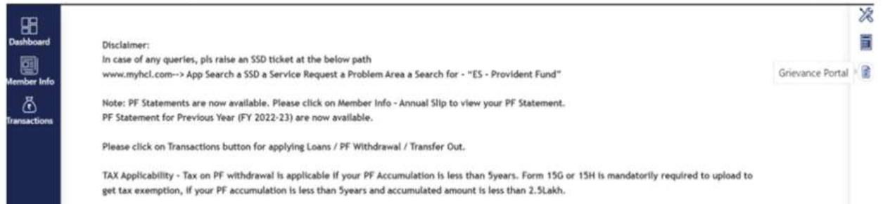
Online Grievance Portal
Step 3: Wait for Auto Login
Wait….for auto login
Step 3.1 : Click on Grievance Portal link

Slide 32
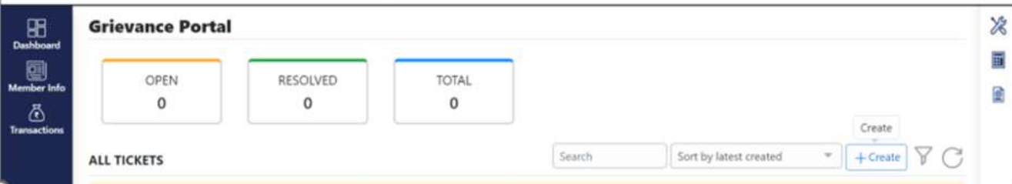
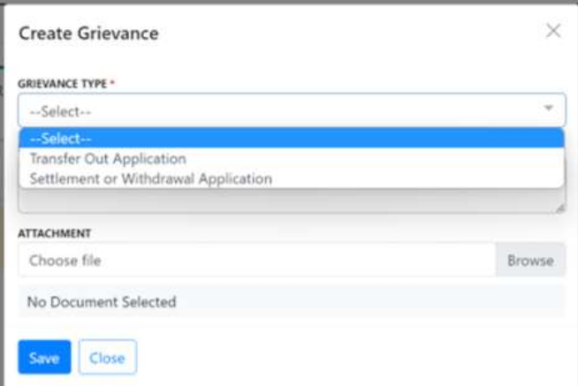
Online Grievance Portal
Step 3.2: Click on Create
Step 3.1 : Select relevant option, attach doc and Save the query.

Slide 33
Voice Helpdesk Contact Details
Emp Category | Subject | Helpline Num | Zone | Call Timing | Days | IVR Option | Email ids/Grievance Portal | Query Response LSA | Login Issue - email
Inactive/left employee | Only PF Withdrawal/ Transfer out query | 0008000403933 | India | 10 am to 5 pm | Monday to Friday | Option 1 : Transfer out RPFC/Trust Option 2 : PF Withdrawal | For ex employees :: Separation Portal / PF Portal/ Click on Grievance icon (available on right corner up on the portal)/ Select Category and write your query. | 3 Working Days | Portal.Login.Issue@hcl.com
 |  | 18556641988 | US
 |  | 08000489162 | UK
Emp Category | Subject | Helpline Num |  | Call Timing (India) | Days | IVR Option | Email ids/Grievance Portal | Query Response LSA
Active / Inactive employee | Pension Query | 0008000403888 |  | 2 pm to 5 pm | Monday to Friday | Pension Queries | pensionhelpdesk@hcl.com | 3 Working Days
 | Aadhar Correction, UAN query, Name Correction etc. | 7303883281 |  | 11 am to 5 pm | Monday to Friday | KYC Helpline / Query | hcl_pf.withdrawal@hcl.com

